Slide 1
Opportunity
Smudging
On paper
On hand
Artists, left handed people
Re-scoping
Re-scoping to not include people with hand mobility issues
Addressing different issues to smudging, would be make designs more difficult/overconstrain
Scoped out solutions that create new mediums, focusing on designs that will be useable for a variety of mediums
Unpractical to have a completely new system/medium to use, i.e. cant change medium for art
We value versatility

Slide 2
Re-scoping

Slide 3
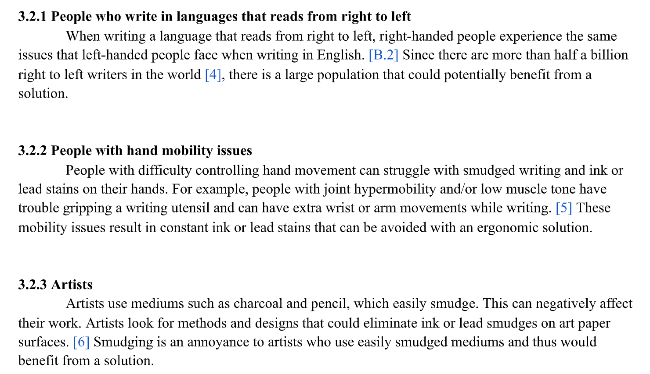

Slide 4
Objective Modifications

Slide 5
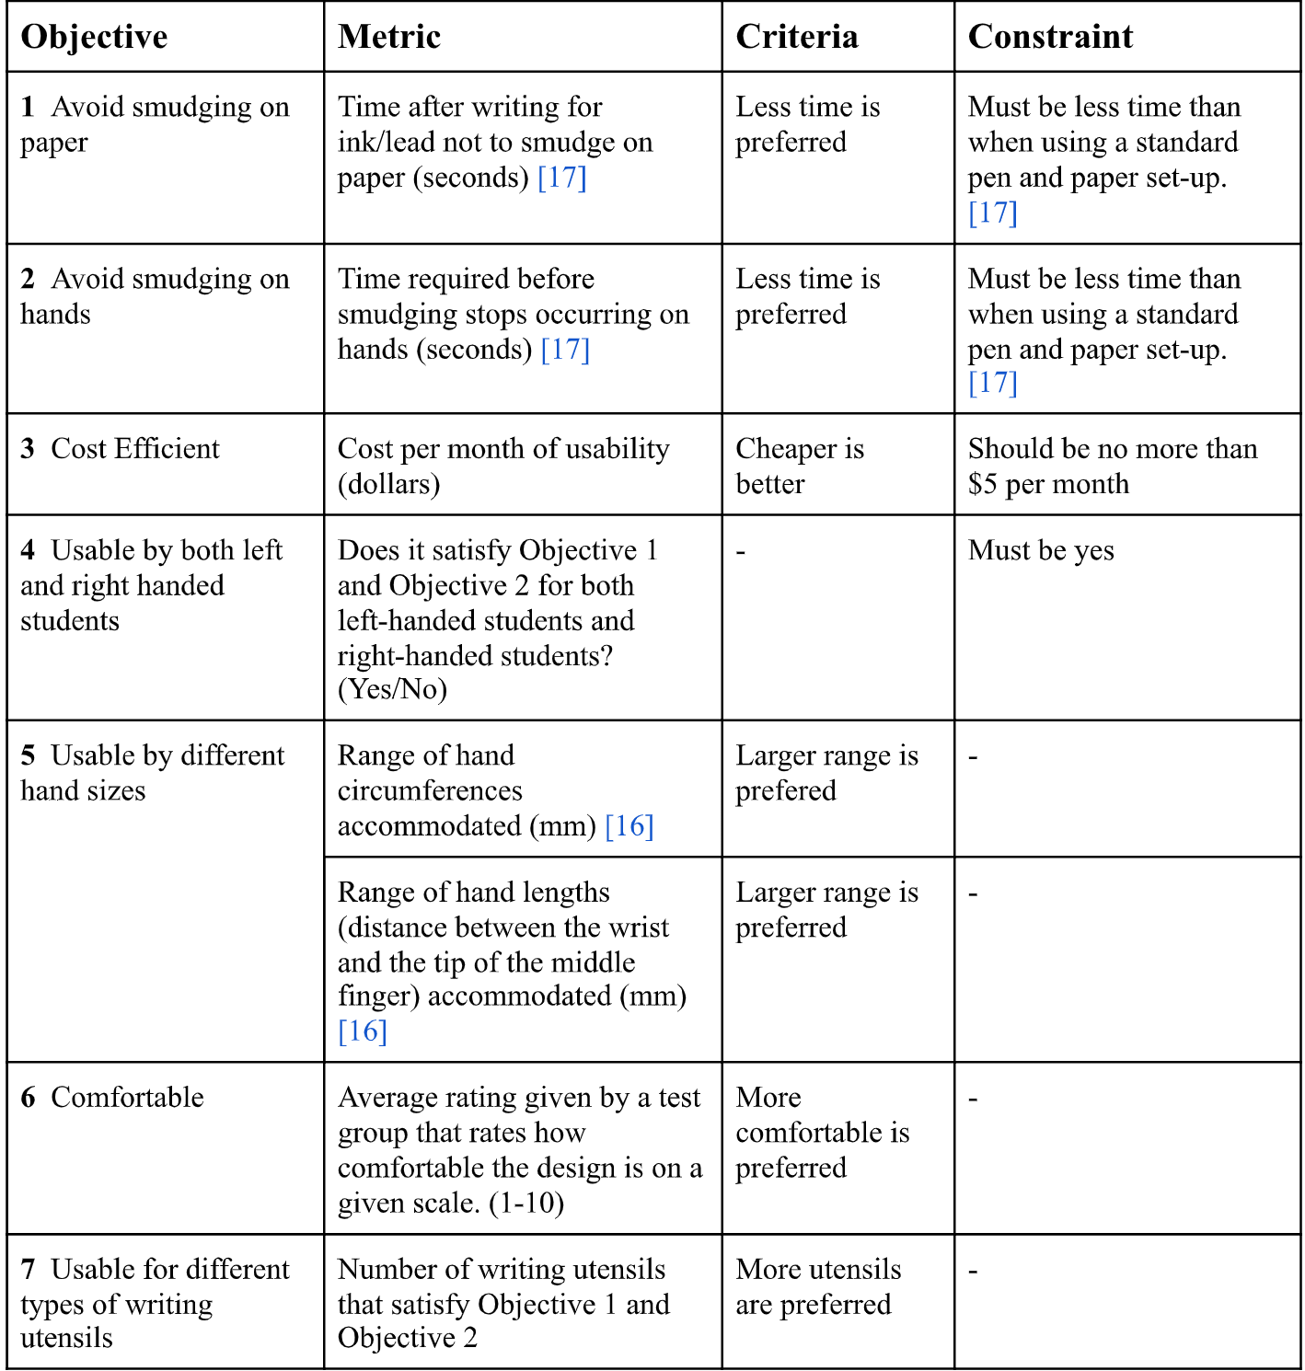
Changed metrics to taylor for a device, not medium

Slide 6
Requirements
Avoid smudging on paper
Metrics
Surface contact with paper (area mm^2)
Smudge test (area mm^2):
Write with medium (ink/graphite), specified for a test
Smudge with device if applicable
Measure how much the ink spreads from original position
Avoid smudging on hand
Metric
How much ink/graphite is on your hand after formalized test (area mm^2)
Cost efficient
No longer cost per month but just the total cost ($)
No more constraint as was arbitrary
Usable by both handedness (keep as is)
Usable by different hand sizes (keep as is)
Comfortable (keep as is, however, needs more thorough guidelines)
Usable by different writing mediums (keep as is)
Ergonomics added
Metric, how many of the UCLA checklist items the design fits
Notes:
Comfortability qualitative assessment
Balance for different stakeholders: students, artists, left right handed
Variety of tests
More defined metric of how to measure comfort

Slide 7
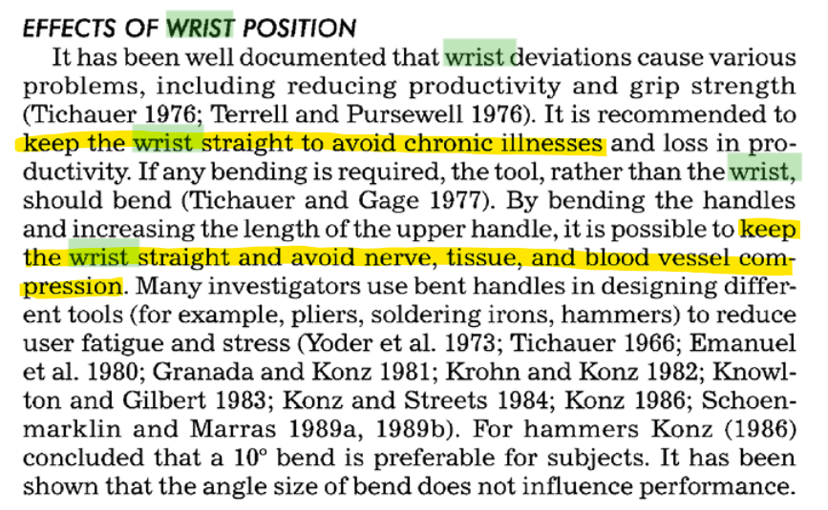

Slide 8
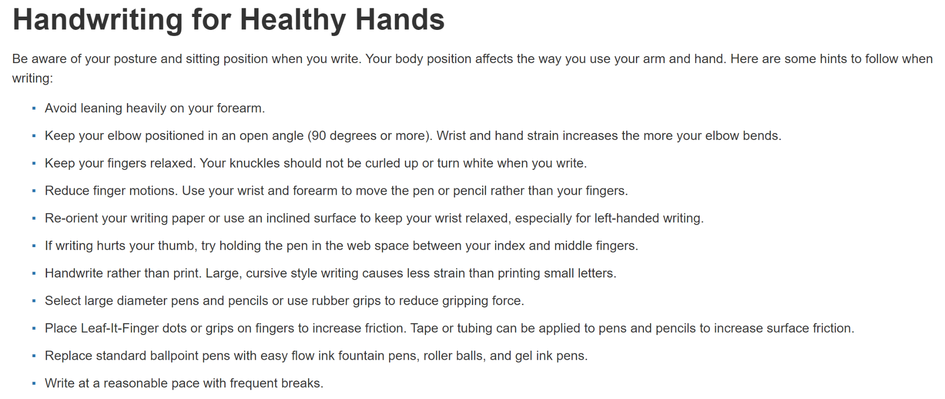
1
2
3
4
5
6
7
8
9
10
11

Slide 9
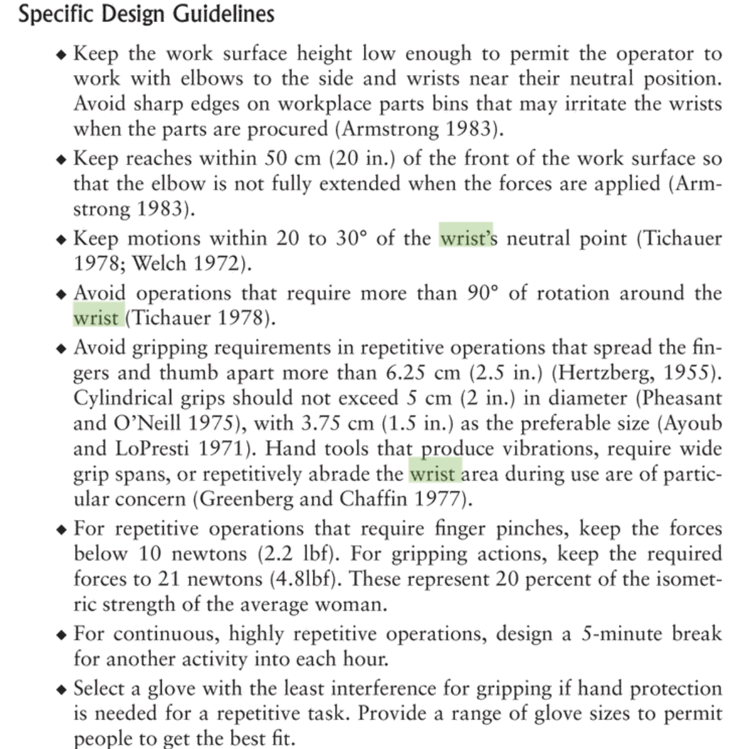
movement
Basics of gripping and repetitive motion

Slide 10
Design Process

Slide 11
Design Process (Tools + Evaluation)
3-6-5
Good for lots of idea generation / start to thinking of designs
Started independently so no anchoring
Collaboration without having to talk over someone
Biomimicry
Further developed scratching idea (scoped out later)
Wax tablet idea
Reverse brainstorming
Helped evaluate original objectives
Examples???
Morphing
1st morph chart we had new medium/changing medium as an option, realized it was not a feasible idea
Generally: defined our ideas/put them on paper - as a team we do a lot of work through discussion
Scamper
Figured out that we can combine support and hand protection, horizontal and vertical movement also combined
From scampering 1st morph chart, the new medium and preventing smudging were two separate issues
Notes:
Best Tool
3-6-5 helped generate a lot of the initial ideas
Other tools were more used for refining ideas/modifying ideas

Slide 12
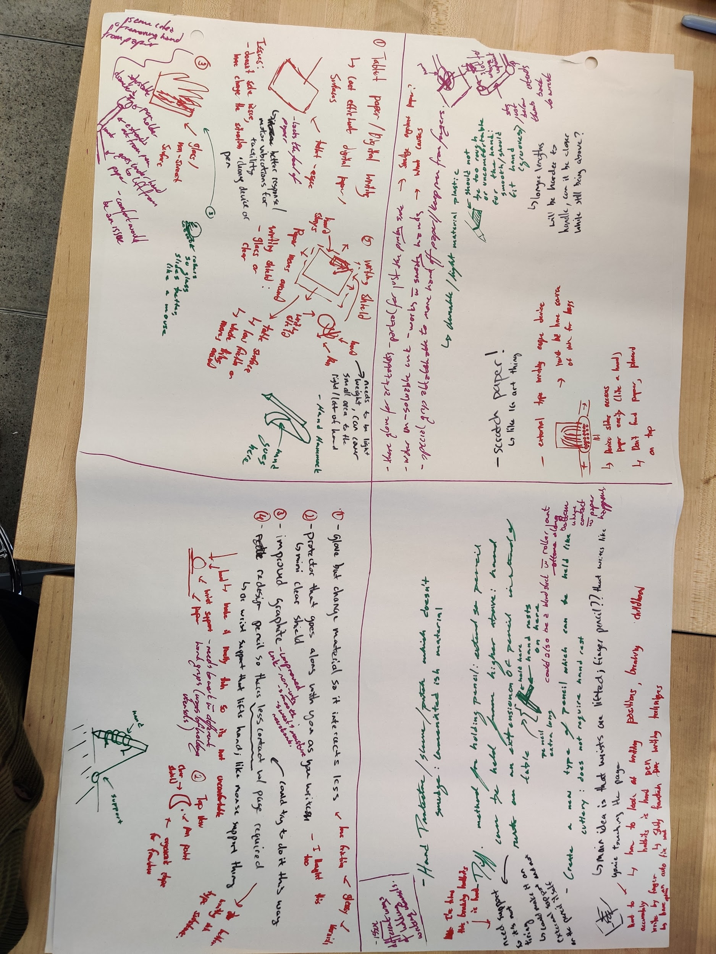

Slide 13
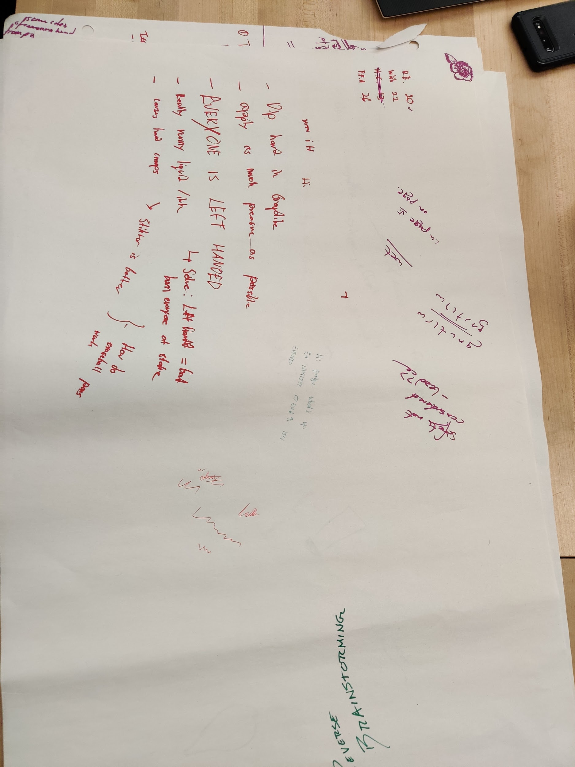
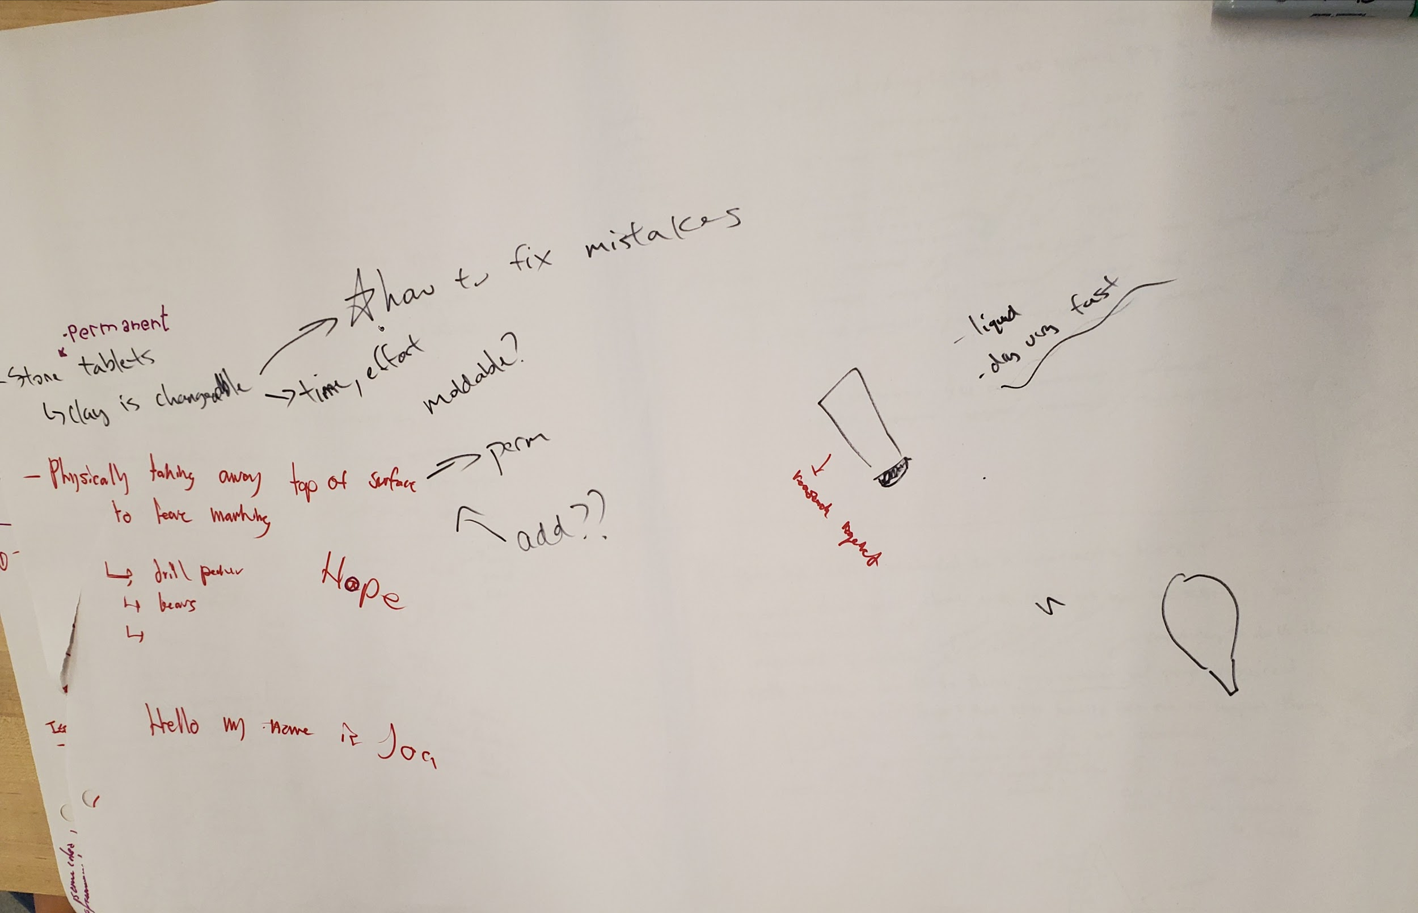

Slide 14
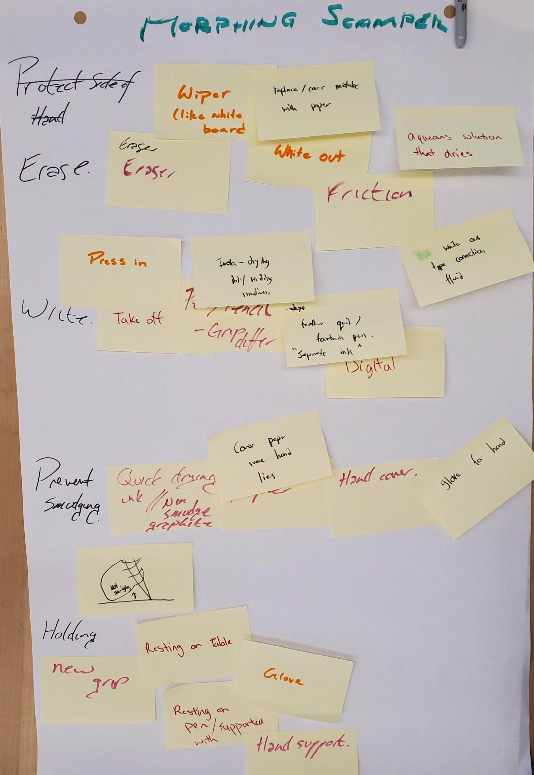
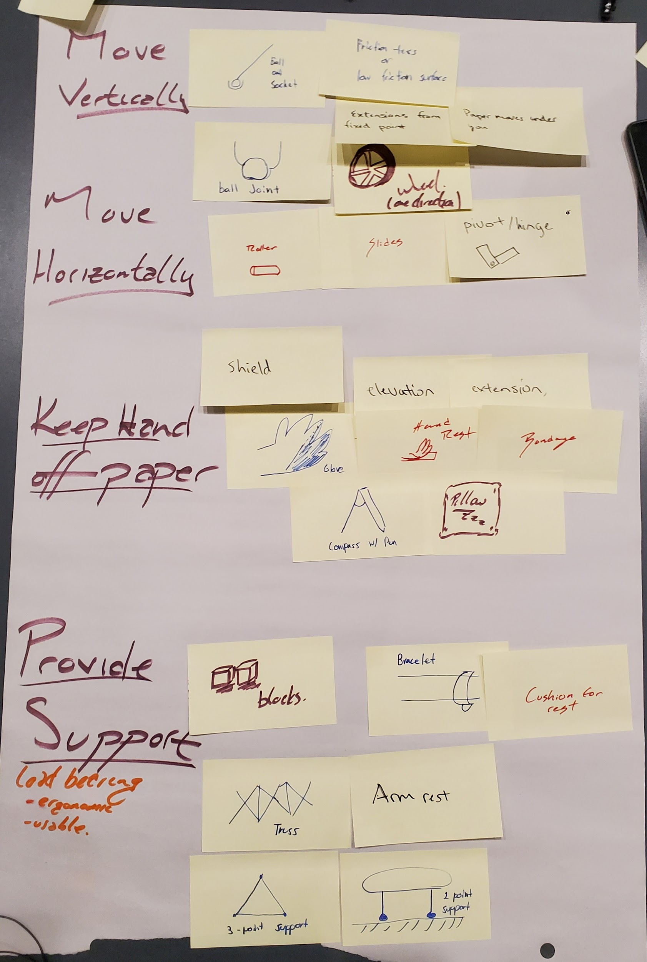
First
Second

Slide 15
Prototypes

Slide 16
Prototypes, general design, pros cons, main aspects
1. Wristband / Bracelet
Light, easily adjustable
Moves along while writing in an intuitive/easy way
2. Scaffolding
Provides best support for arm
Clunky, not carried easily everywhere (stationary artist)
3. Pillow Arm Brace
Focused around support and ergonomics
A little clunky
4. Hand shield
Really easy, and cheap
Restrictive / not comfortable to write with, not the best at stopping smudging
5. Compass / art easel
Easy to employ, keeps hand off the page
comfort??
6. Marionette Utensil contraption
No surface area touches the paper
Complicated desk setup, hard to have controlled actions
Notes:
Prototypes focused on:
Positioning
Comfort
support

Slide 17
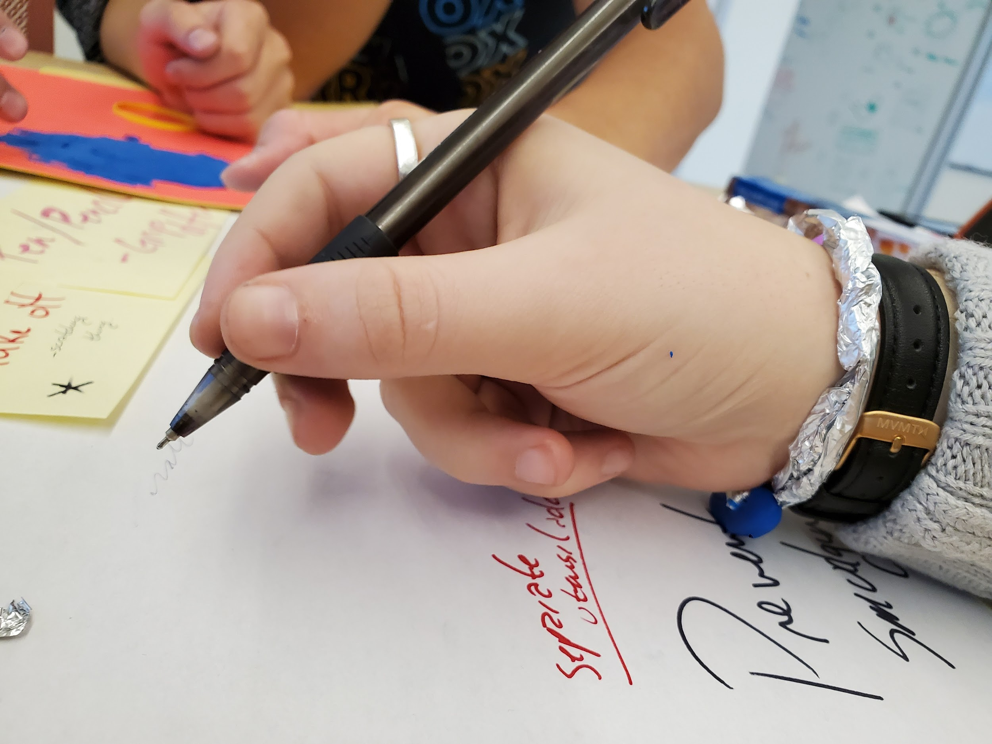

Slide 18
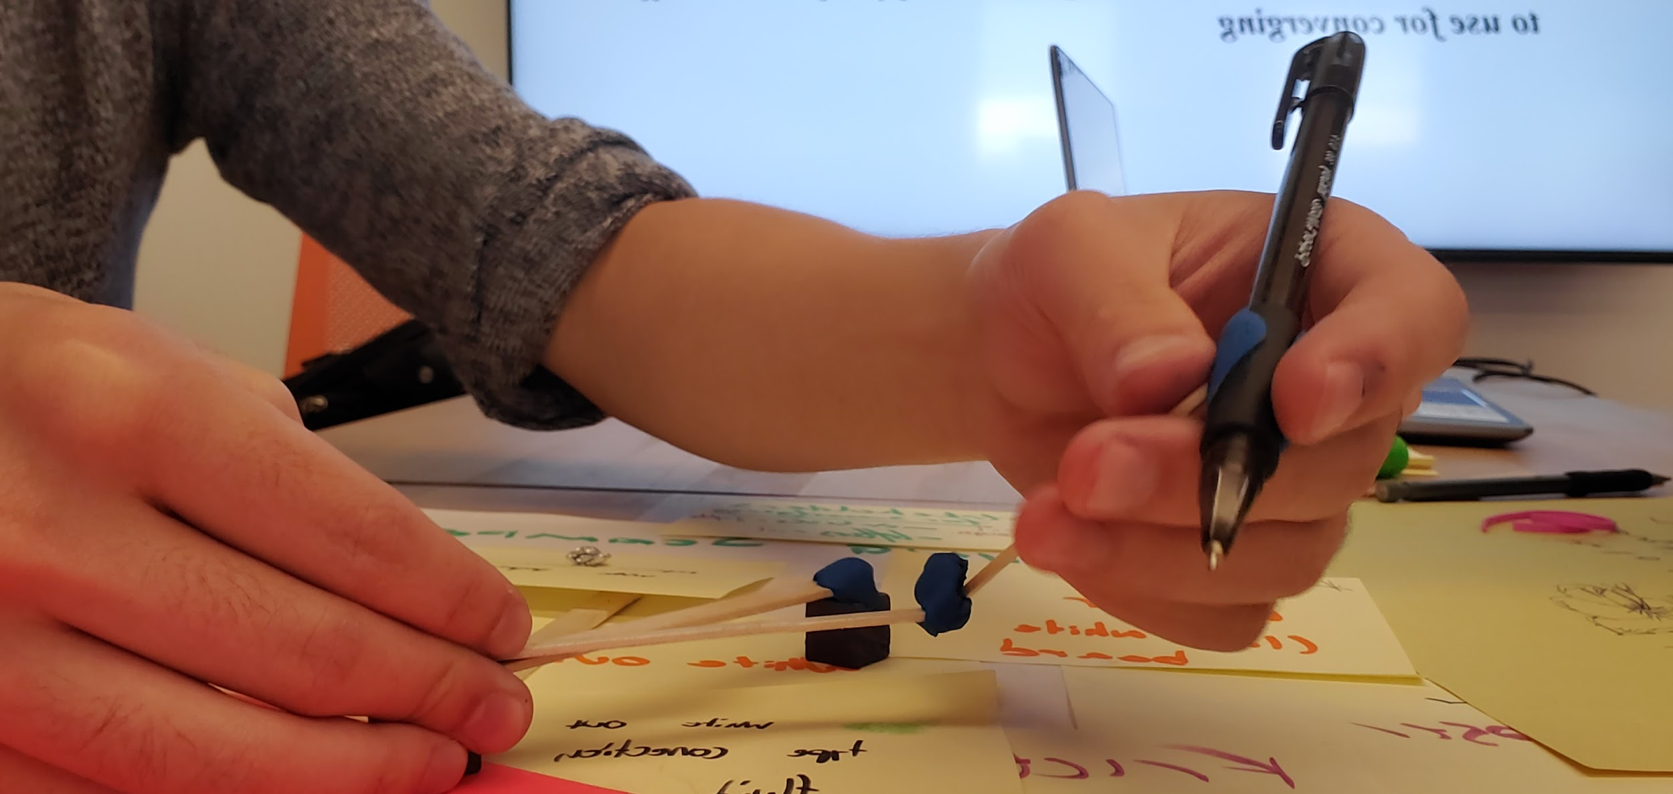

Slide 19
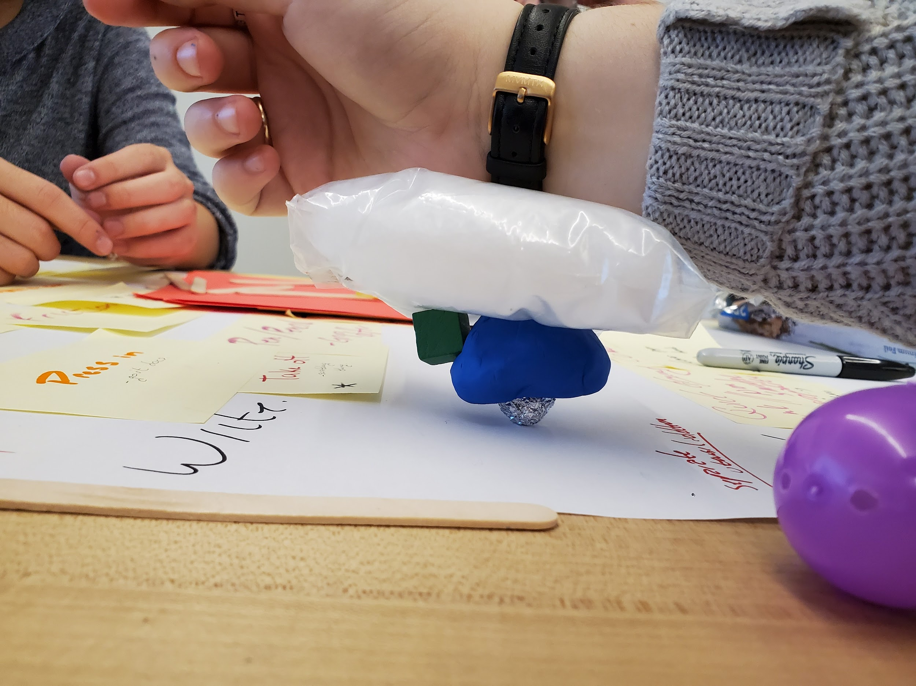

Slide 20
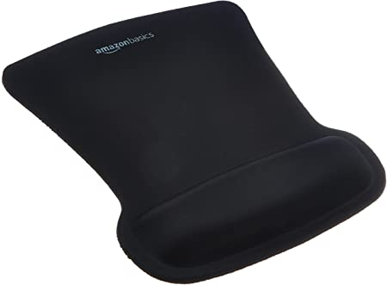

Slide 21
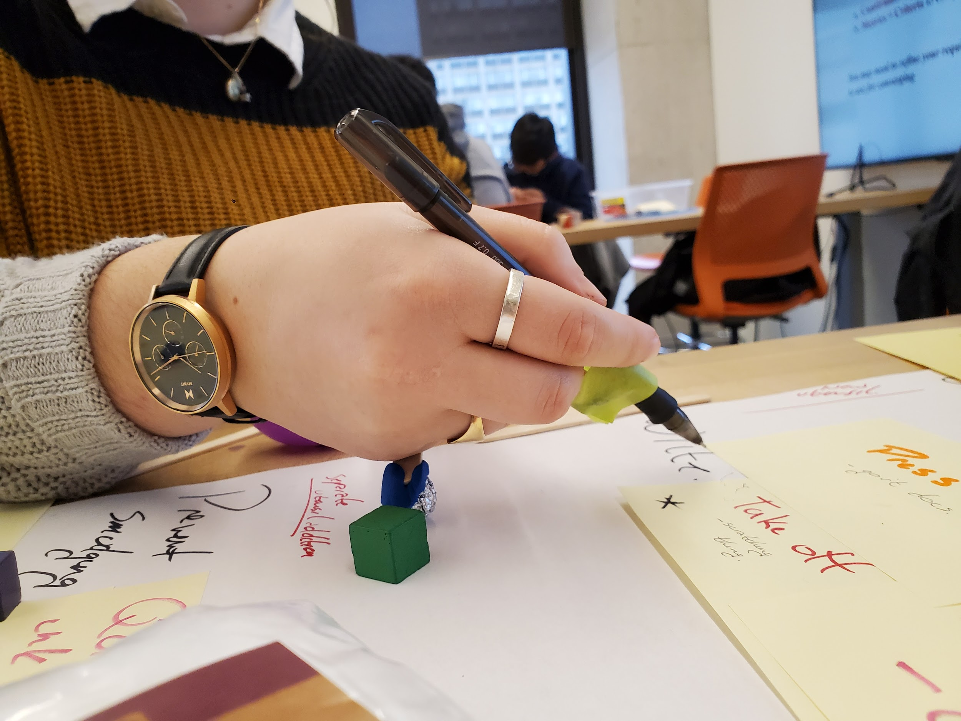

Slide 22
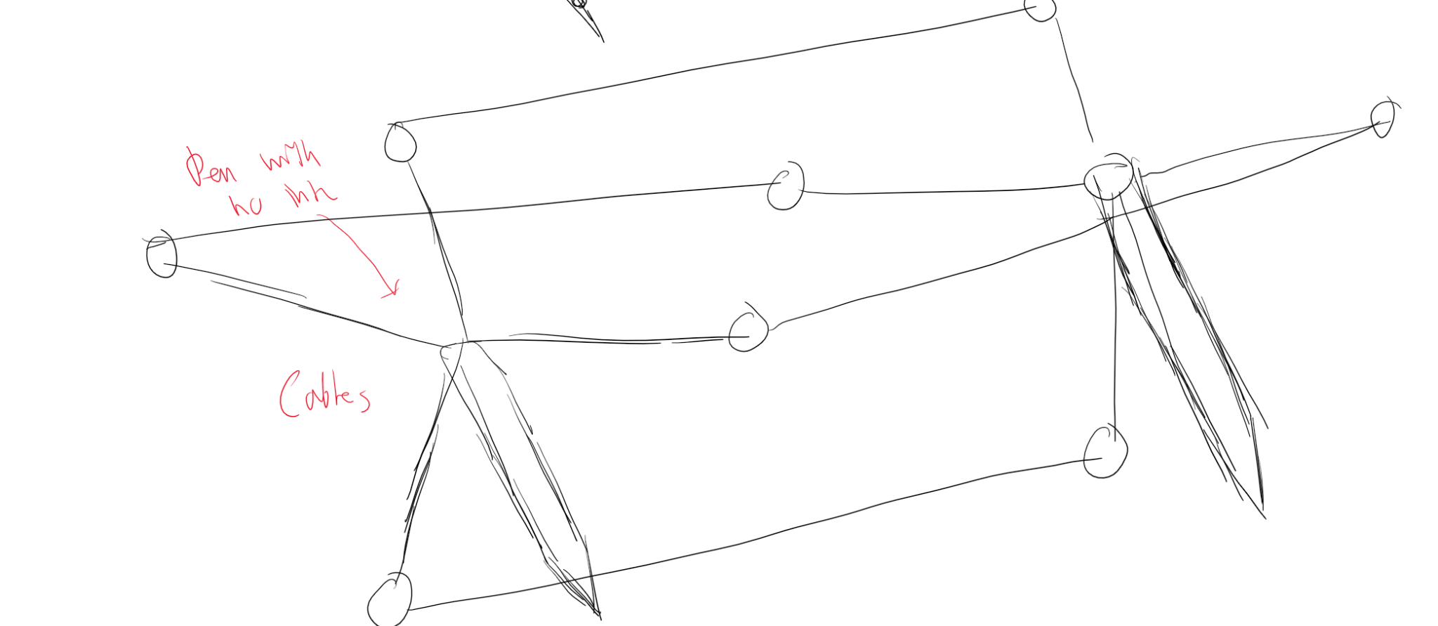

Slide 23
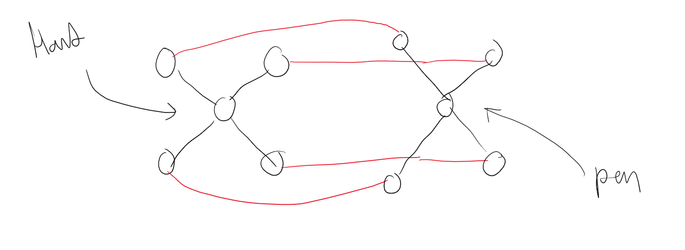

Slide 24
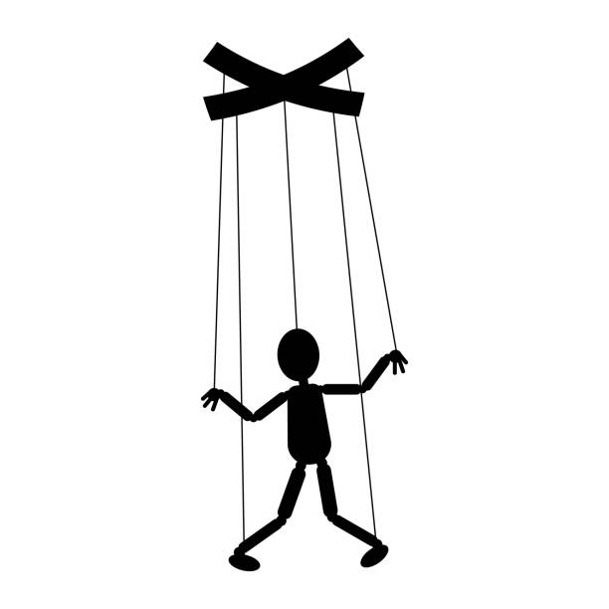

Slide 25
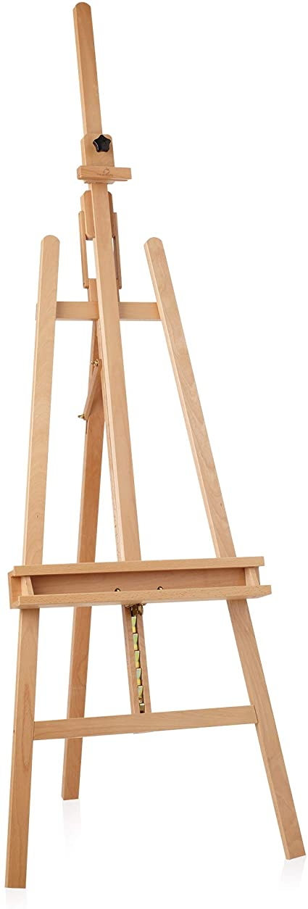

Slide 26
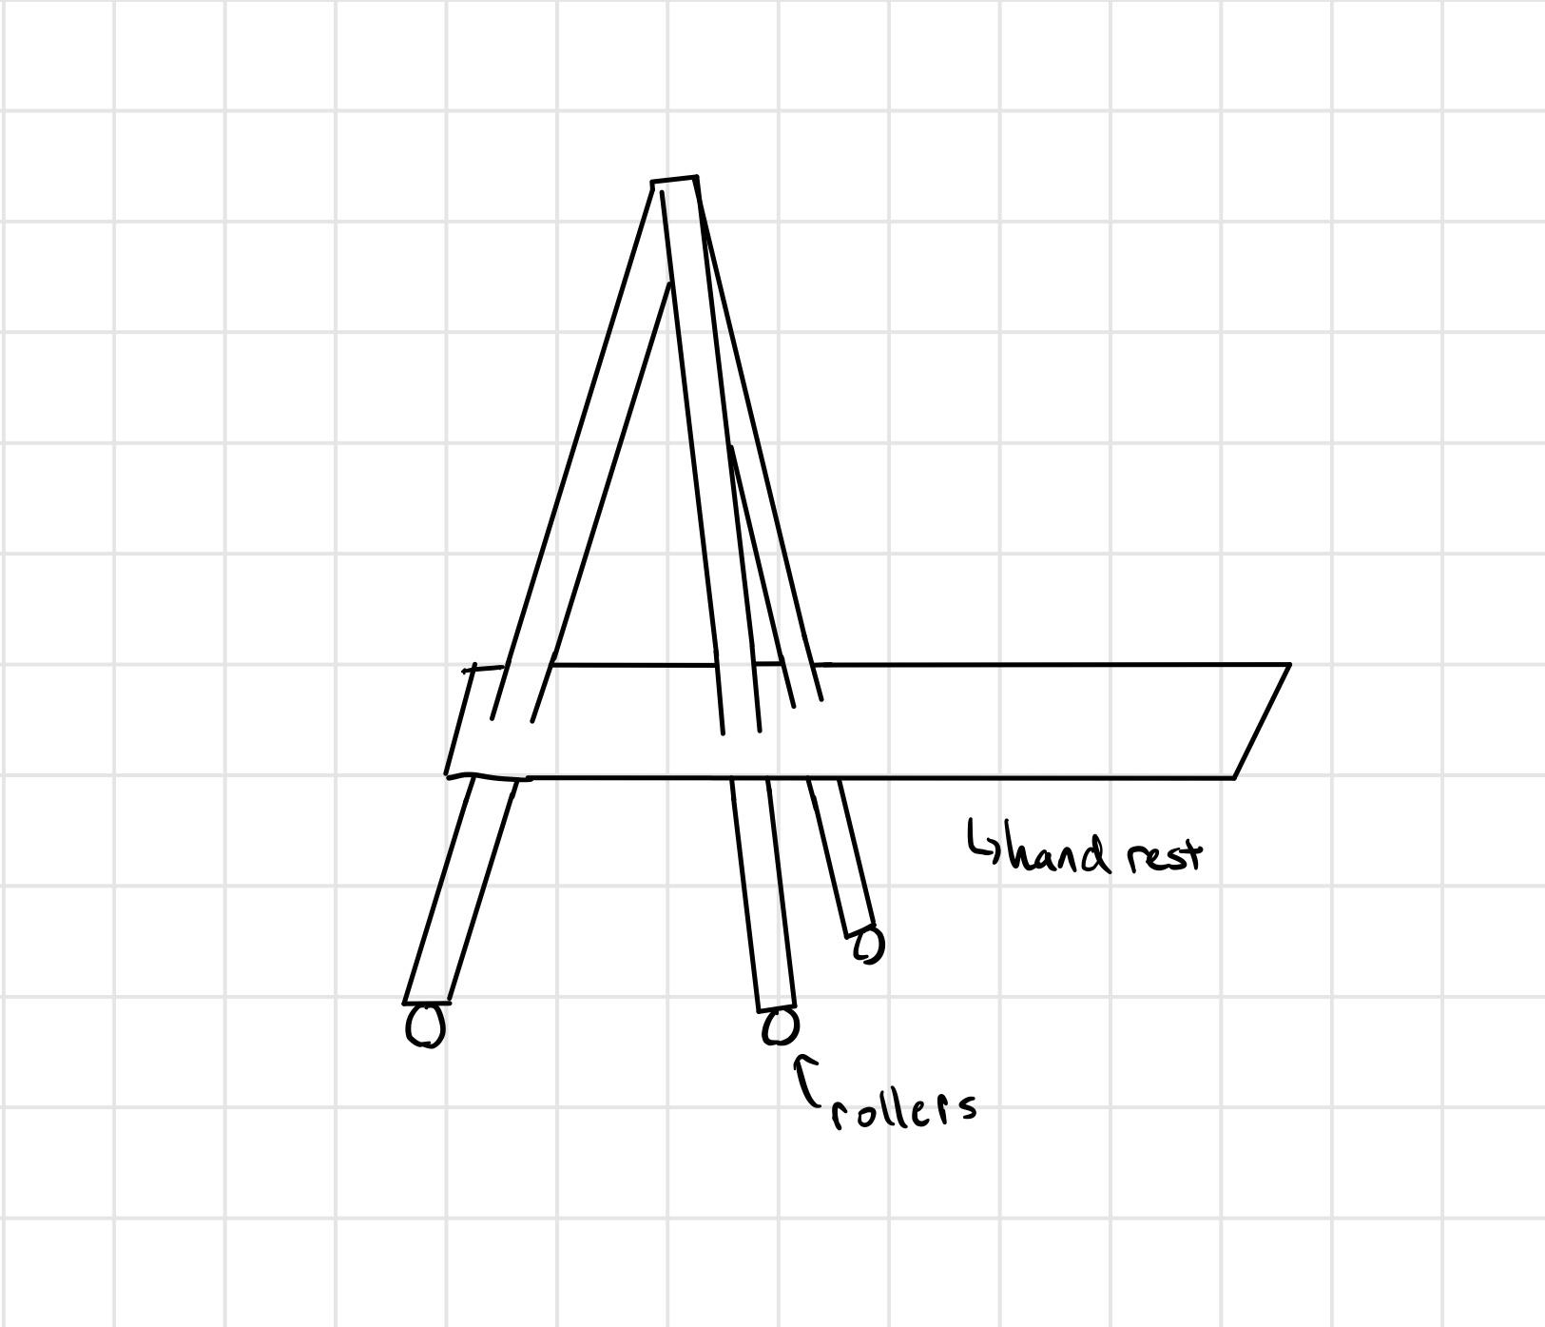

Slide 27
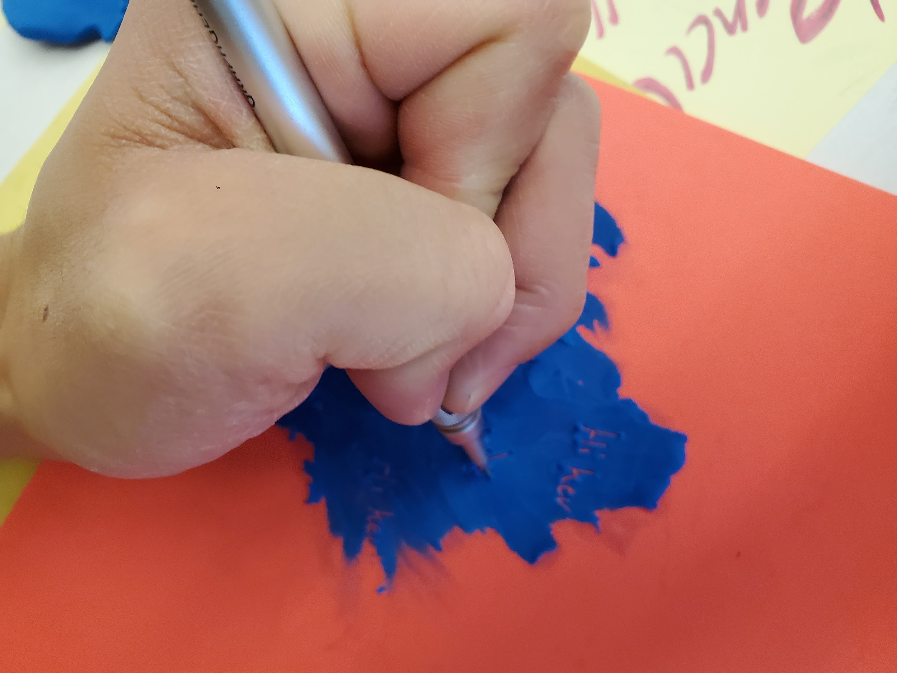
Notes:
NO MORE
Was scoped out because not remaking the medium, also had challenges with erasability

